Slide 1

Segmentation & Clustering of New York and Toronto
Capstone Project - The Battle of Neighborhoods
Nikhila Anumukonda

Slide 2
Contents
Introduction
Data acquisition& preparation
Clustering
Cluster analysis
Conclusion

Slide 3
Introduction
Problem Statement
Target Audience

Slide 4
Problem Statement & Target Audience
A young business entrepreneur from India is looking to migrate to Toronto or New York and setup a business in Toronto or New York. He needs to decide between the two options New York or Toronto. In this scenario, he wants to understand which categories of business are popular in Toronto and New York, which categories of business are rare and niche. He also wants to understand the neighboring business venues.
The audience have the following profile.
He is a Indian citizen with dreams to migrate to New York or Toronto because they are the business centers in their respective countries.
He does not know much about the New York and Toronto and their neighborhoods, hence he wants to understand feasibility of setting up business in the neighborhoods.
He is exploring what kind of business has less competition and which neighborhoods.
He has a family with skills to run the business.
He likes to live in a neighborhood with ample open spaces.

Slide 5
Data acquisition and preparation
Neighborhood Data
Venue Data

Slide 6
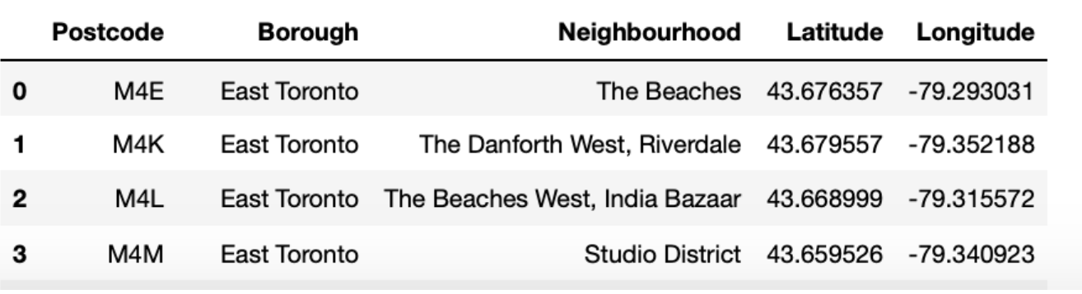
Meaning
Data Acquisition
Neighborhood Data (Toronto)
Source for Canada Data : Wikipedia page titled “List of postal codes of Canada: M”.
Source for Geospacial Data : https://cocl.us/geospatial_data
The following steps were performed on the Toronto Data for Data preparation
Scrape the data from the Wiki page
combine the neighborhoods which have same postcode
replace the name of the neighborhoods which are “Not Assigned” with the name of the Borough
merge the neighborhoods which have same Borough
filter the data having Borough “Toronto”.
Read Geospatial data and merge with Toronto data to get Longitudes and Latitudes.

Slide 7
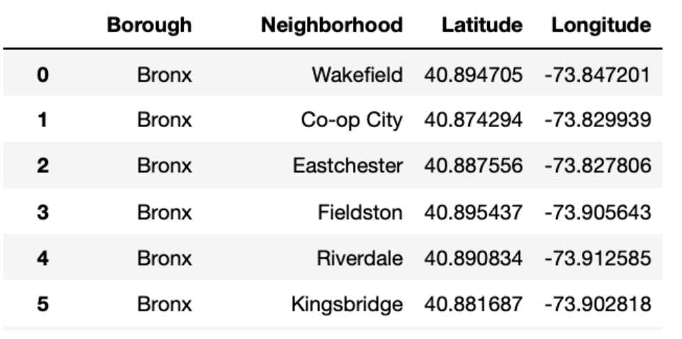
Meaning
Data Acquisition
Neighborhood Data (New York)
Source for New York Data : https://cocl.us/new_york_dataset.
The dataset is a JSON file that specifies the name of each neighborhood, its coordinates—latitude and longitude, its borough combine the neighborhoods which have same postcode
The following steps were performed on the Toronto Data for Data preparation
Neighborhoods that share the same name but are located in different boroughs will include the borough name in the name of these neighborhoods

Slide 8
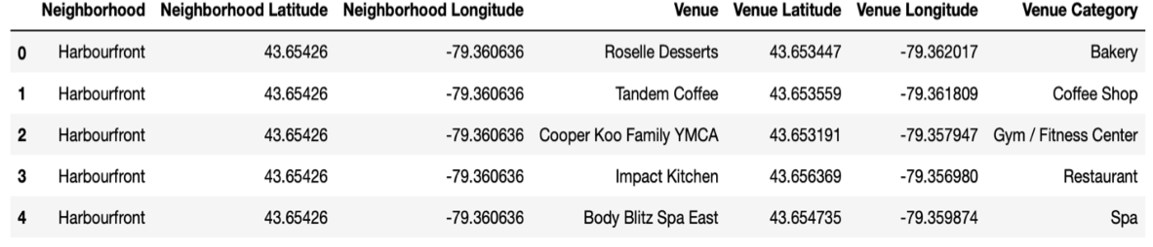
Data Acquisition
Venue Data (Toronto and New York)
Source for New York Data : Foursquare API
To retrieve data from Foursquare using their API, a URL should be prepared and used to re- quest data related a specific location. Search criteria, Client Id, Client Secret, Version, Latitude, Longitude, Radius, Limit are passed.
For example : https://api.foursquare.com/v2/venues/search?&client_id=1234&client_secret=1234&v=20180605&
ll=40.89470517661,-73.84720052054902&radius=500&limit=100
search indicates the API endpoint used,
client_id and client_secret are credentials used to access the API service and are obtained when registering a Foursquare developer account,
v indicates the API version to use,
ll indicates the latitude and longitude of the desired location,
radius is the maximum distance in meters between the specified location and the retrieved venues, and limit is used to limit the number of returned results if necessary.

Slide 9
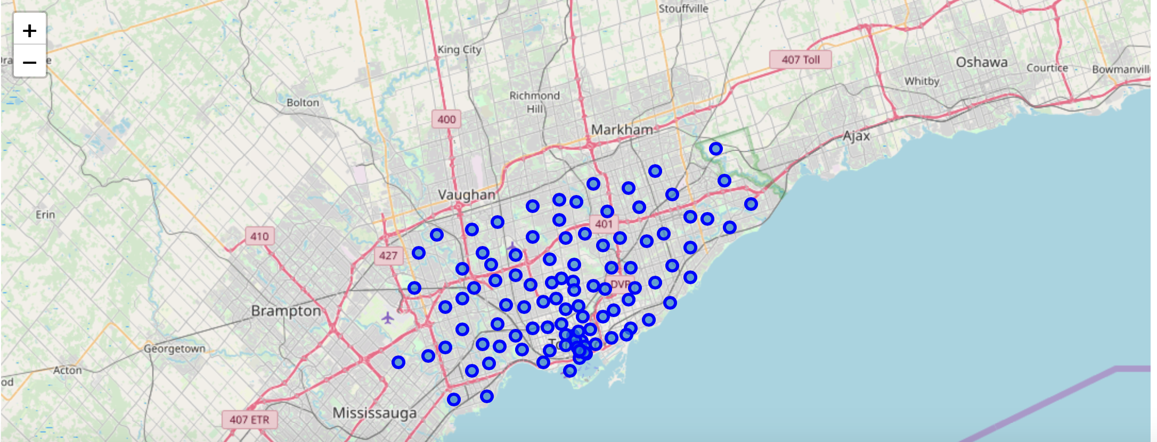
Map of Toronto Neighborhoods

Slide 10
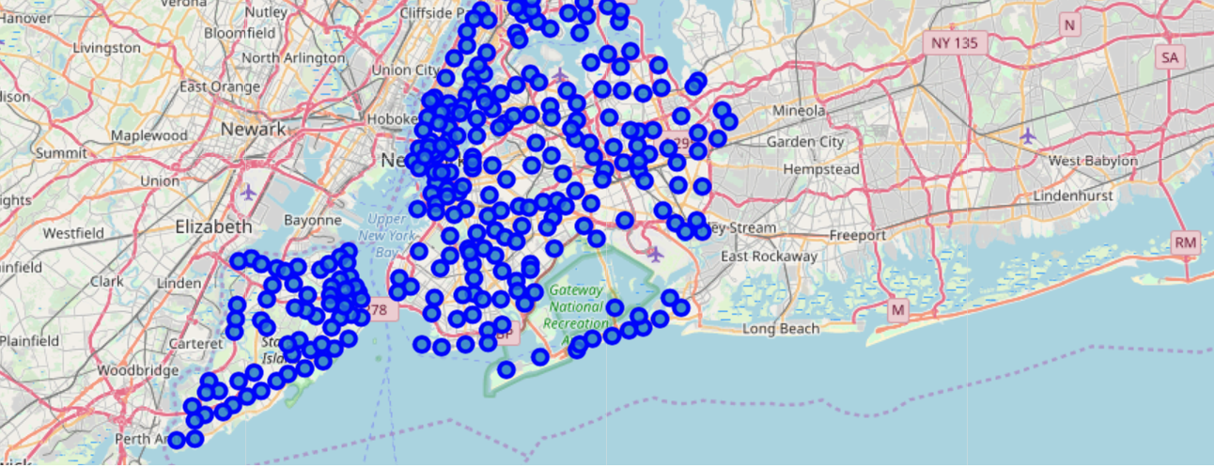
Map of New York Neighborhoods

Slide 11
Methodology
Most Common Venue Categories
Most widespread Venue Categories
Most Rare Categories
Notes:
Consider talking about:
Municipal services
Finance
Governance
Urban planning

Slide 12
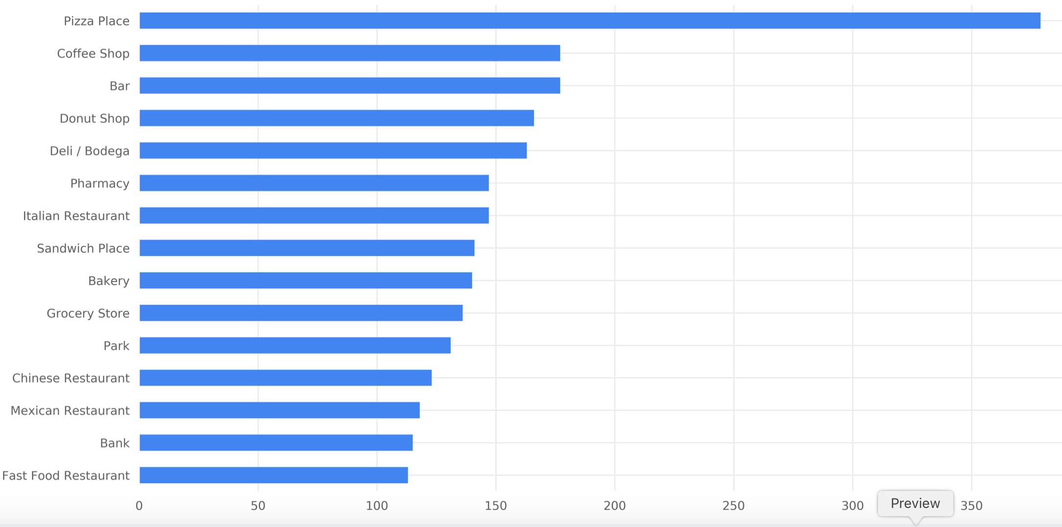
Most Common Venue Categories - NY
New York City
We can see that the most common category is
“Pizza Place” with 400 venues in NYC;
In the second rank, the category “Coffee shop” appears with 175 venues.
In the third rank comes the “Bar” category.

Slide 13
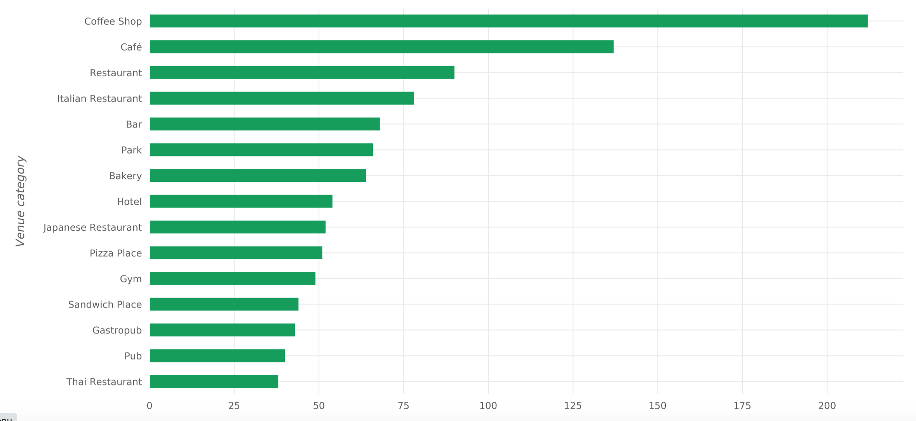
Most Common Venue Categories - Toronto
Toronto
For Toronto, the Top 3 most common venue category is Coffee Shop, Park and Café.
Coffee Shop with 250 venues,
restaurant with 87 venues and
Café with 137 venues.

Slide 14
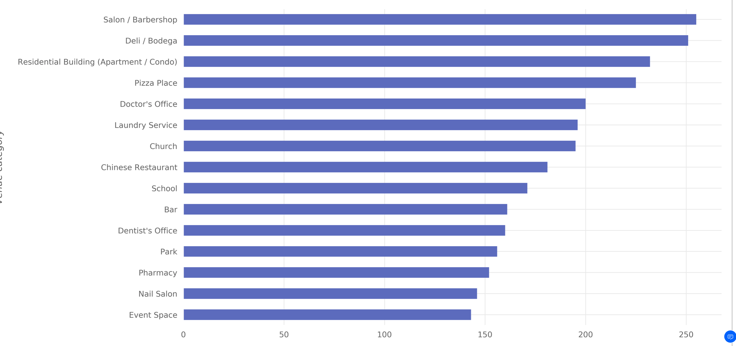
Most widespread Venue Categories - NY
New York City
The most widespread category is “Salon / Barbershop” and exist in 250 neighborhoods out of the 306 neighborhoods.
Next comes the “Deli / Bodega” category with venues in 250 neighborhoods also.
In the third place comes the “Residential Building (Apartment / Condo)” category with venues in 230 neighborhoods.

Slide 15
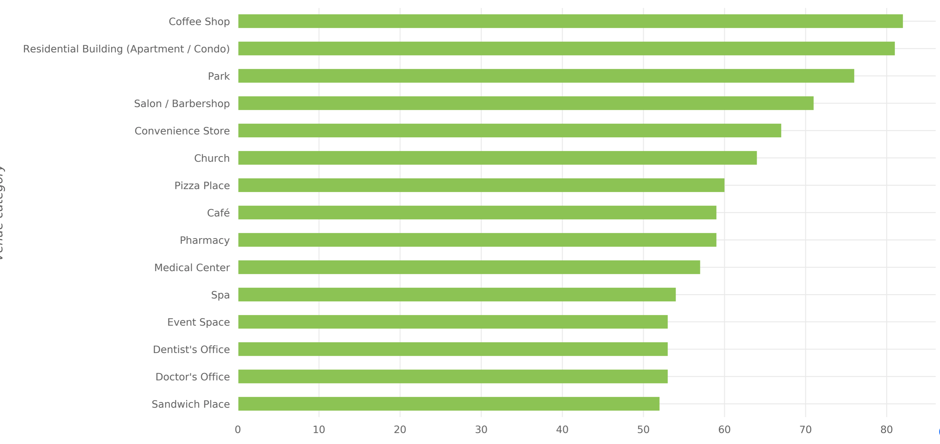
Most widespread Venue Categories - Toronto
Toronto
In the first place comes the “Coffee Shop” category with venues in 80 neighborhoods2.
Then comes “Residential Building (Apartment / Condo)” category with venues in 80 neighborhoods. And the third most-widespread category is “Park” with venues in 75 neighborhoods.

Slide 16
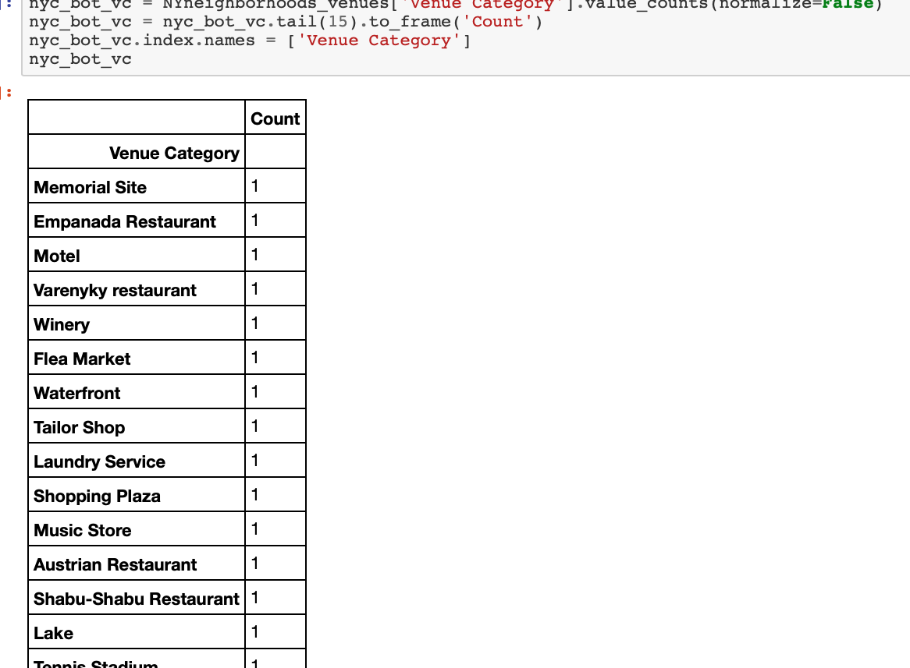
Rare Categories in New York
Certain Venue categories are Rare. It might be feasible to select one of these categories to set up business as there would be less competition. For example:
Motel
Laundry Service
Music store
Austrian restaurant

Slide 17
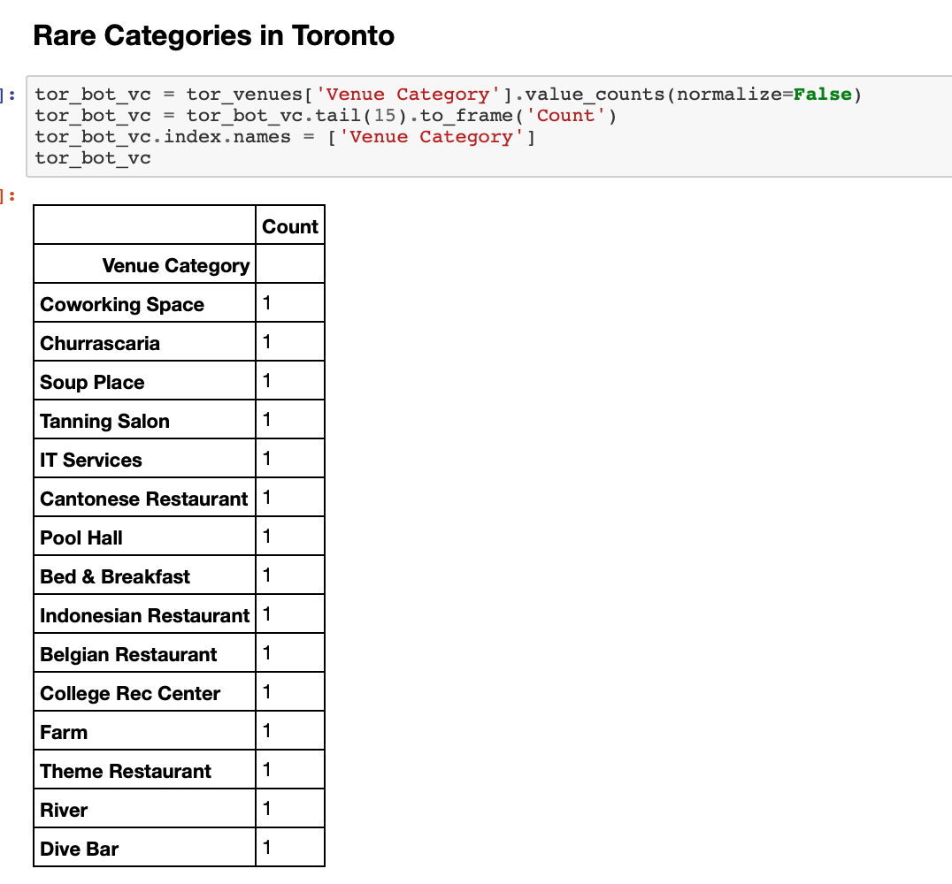
Rare Categories in Toronto
Certain Venue categories are Rare. It might be feasible to select one of these categories to set up business as there would be less competition. For example:
Salon
IT Services
Theme Restaurant

Slide 18
Results
Clustering of Neighborhoods
Notes:
Consider talking about:
Municipal services
Finance
Governance
Urban planning

Slide 19
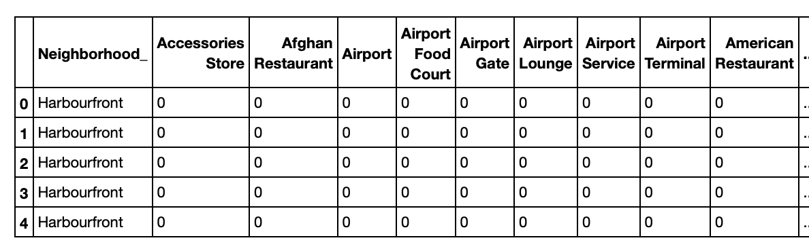
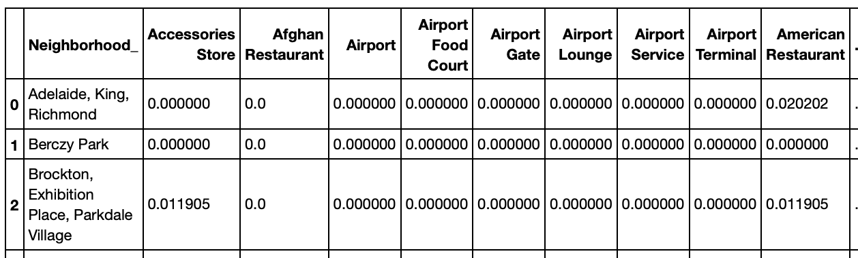
Infrastructure
K-means clustering algorithm
- Preparing the data
Prepare the data for K-means clustering algorithm :
The following steps are performed on the data since K Means takes numerical values only.
apply one-hot encoding on “Venue Category”
aggregation on “Neighborhood”
This process is applied for both Toronto, New York datasets separately
Grouping rows by neighborhood and taking the mean of the frequency of occurrence of each category for each neighborhood
Notes:
Consider talking about:
Utilities
Transportation
Housing

Slide 20
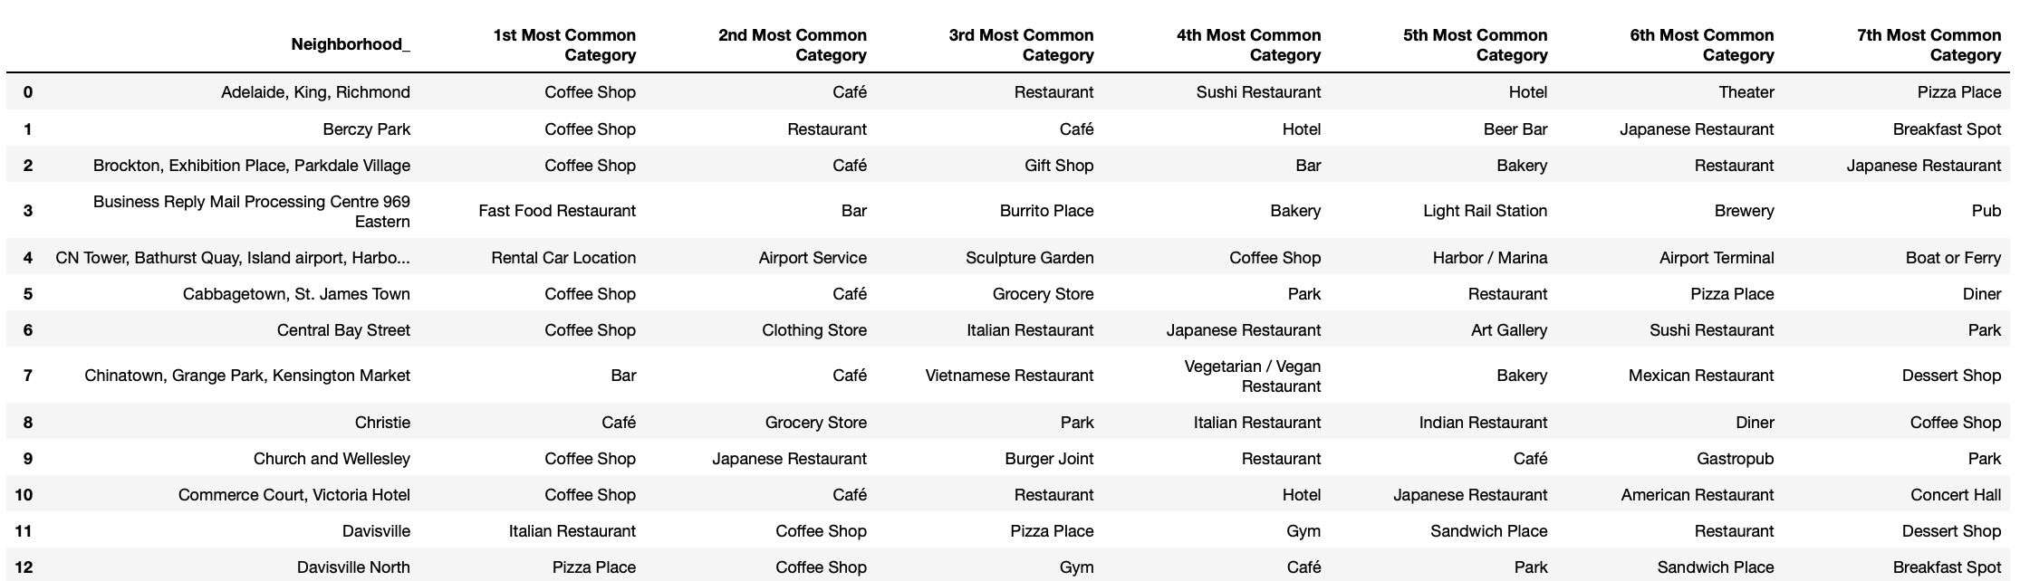
7 most common venues in Toronto neighborhood

Slide 21
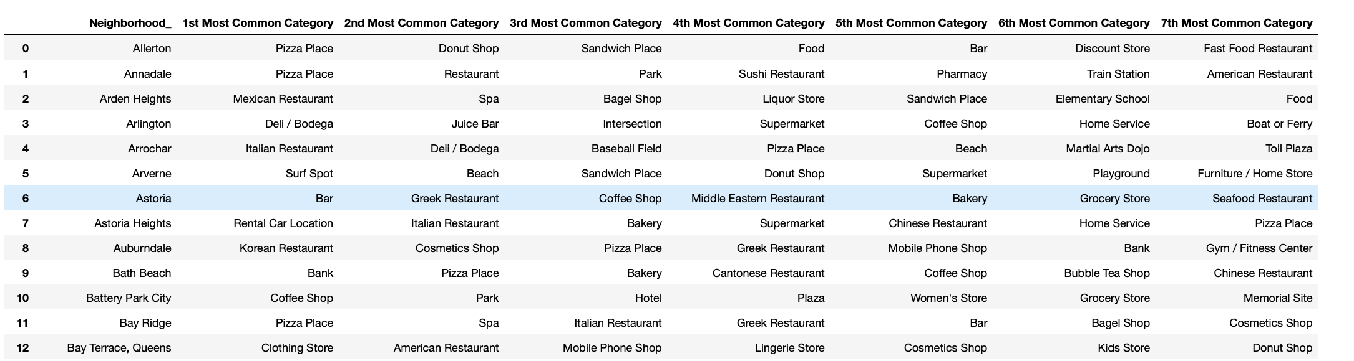
7 most common venues in New York neighborhood

Slide 22
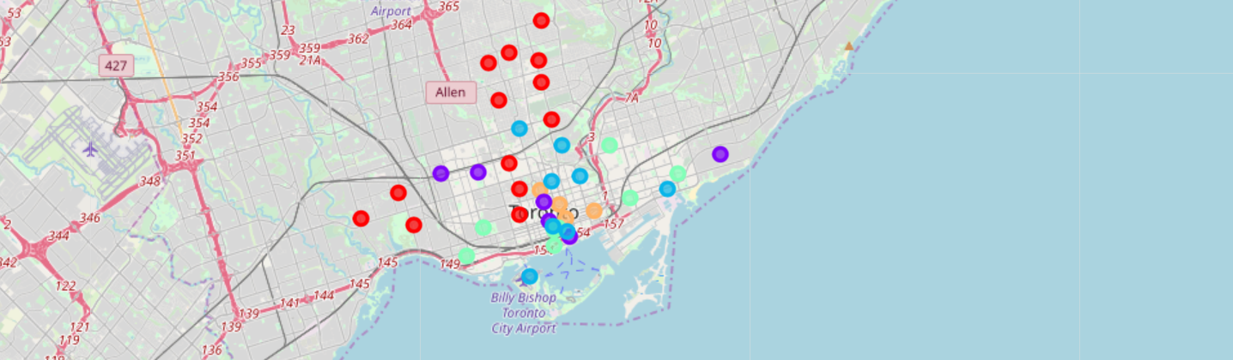
clustering of the Toronto neighborhoods

Slide 23
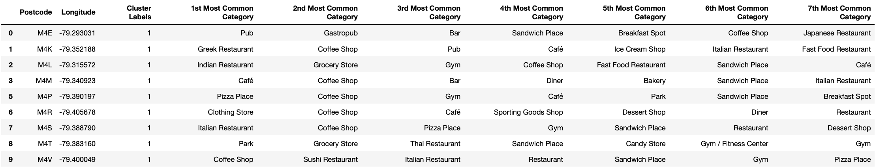
Toronto Clusters
Cluster 1
Cluster 2 – part of cluster dataset of 35 clusters

Slide 24
Toronto Clusters
Cluster 3
Cluster 4
Cluster 5

Slide 25
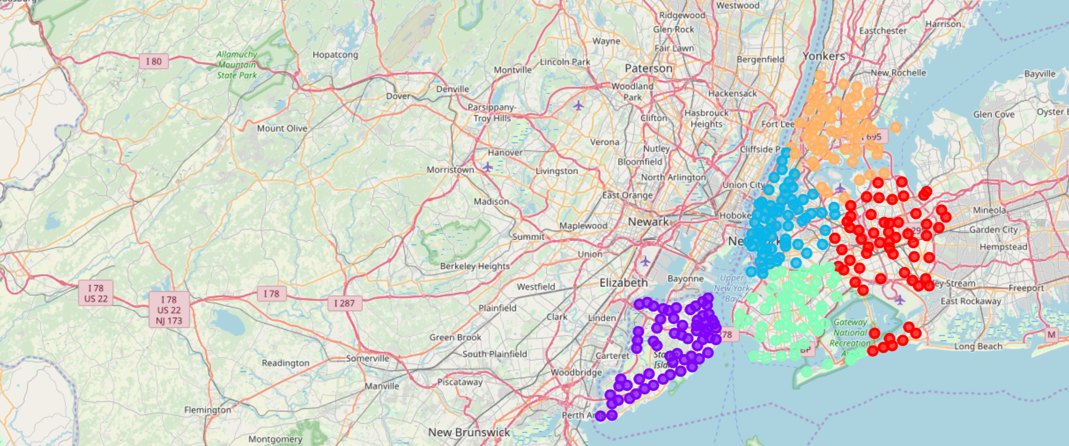
clustering of the New york neighborhoods

Slide 26
New York Boroughs
BRONX
MANHATTAN
BROOKLYN
QUEENS
STATEN ISLAND

Slide 27
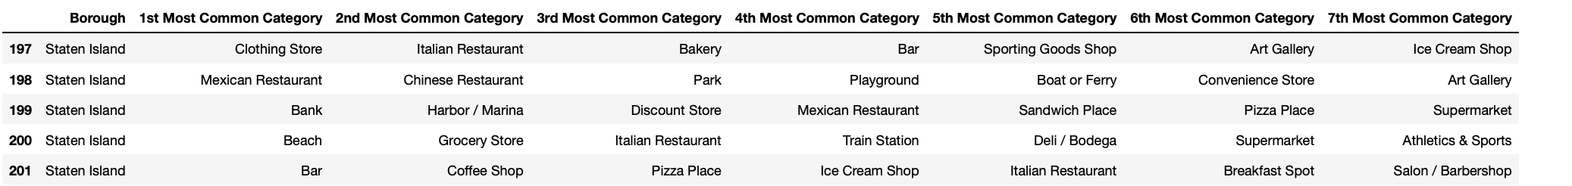
clusters for New York
Cluster 1
Cluster 2

Slide 28
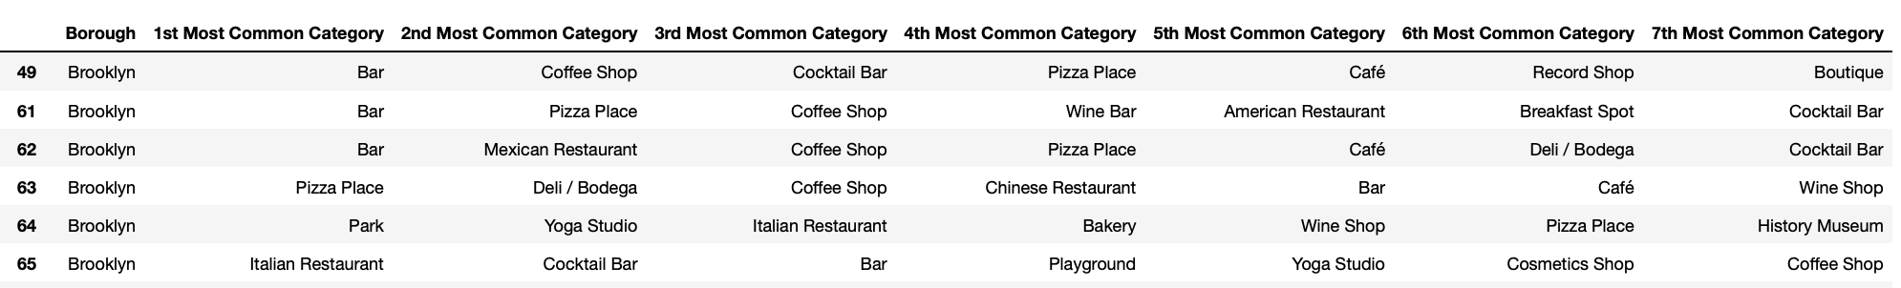
clusters for New York
Cluster 3
Cluster 4

Slide 29
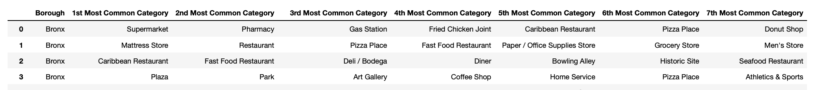
clusters for New York
Cluster 5

Slide 30
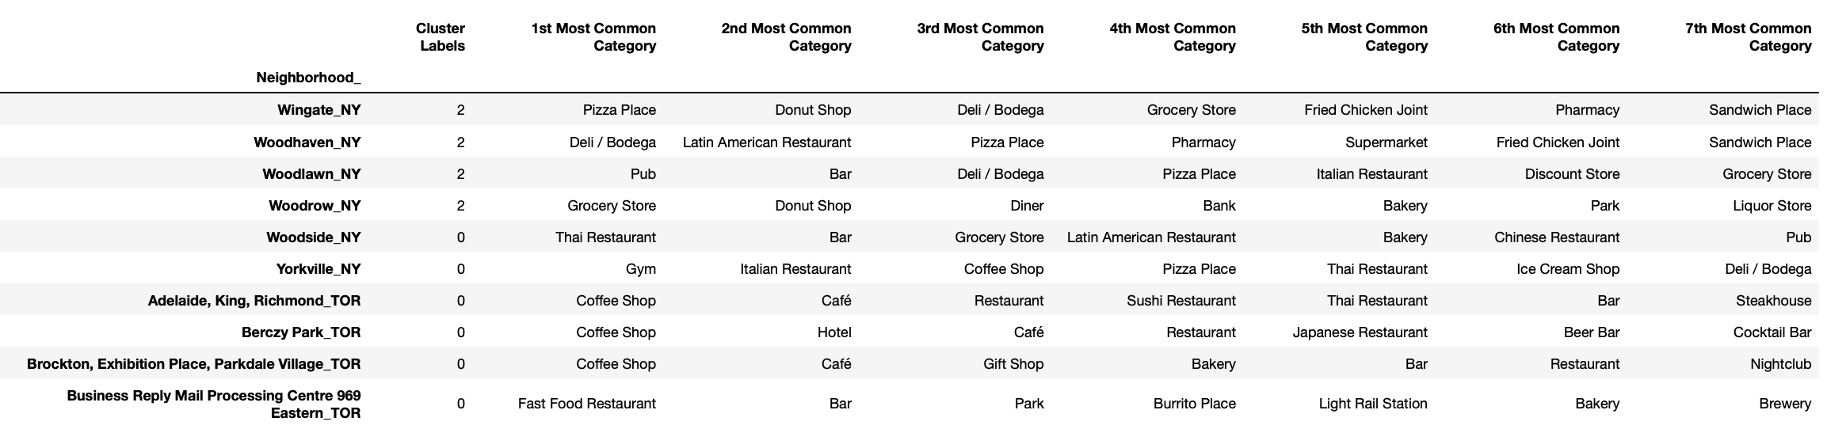
Representation in culture
Combining NYC and Toronto Data Neighborhoods
Most common venue categories in each neighborhood after Clustering K=5
The below Table shows the number of neighborhoods in each cluster. The clustering algorithm was run on 406 neighborhoods in NYC and Toronto.
Cluster | 0 | 1 | 2 | 3 | 4
Num of neighborhoods | 91 | 175 | 81 | 33 | 28

Slide 31
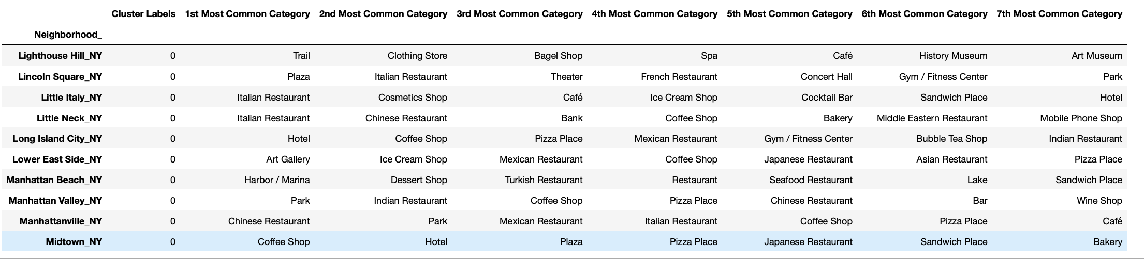
Works cited
Cluster 1
Some records that belong to the first cluster

Slide 32
Works cited
Cluster2
Some records that belong to the second cluster

Slide 33
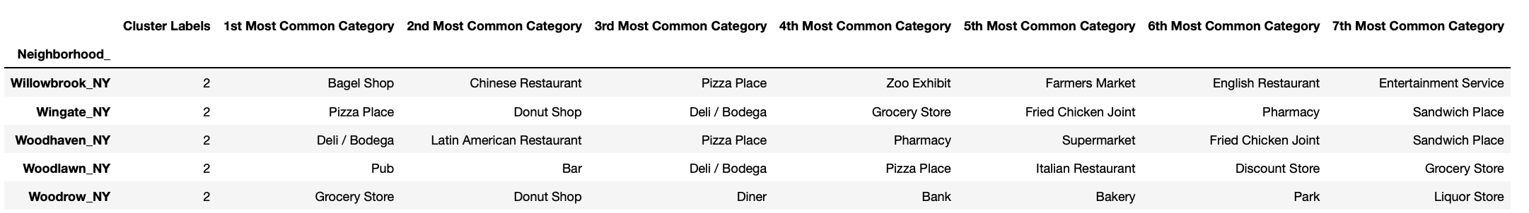
Cluster 3
Some records that belong to the third cluster

Slide 34
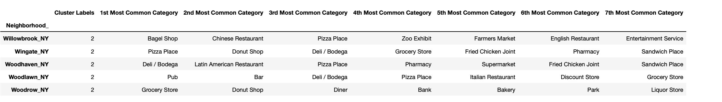
Works cited
Cluster 4
Some records that belong to the fourth cluster

Slide 35
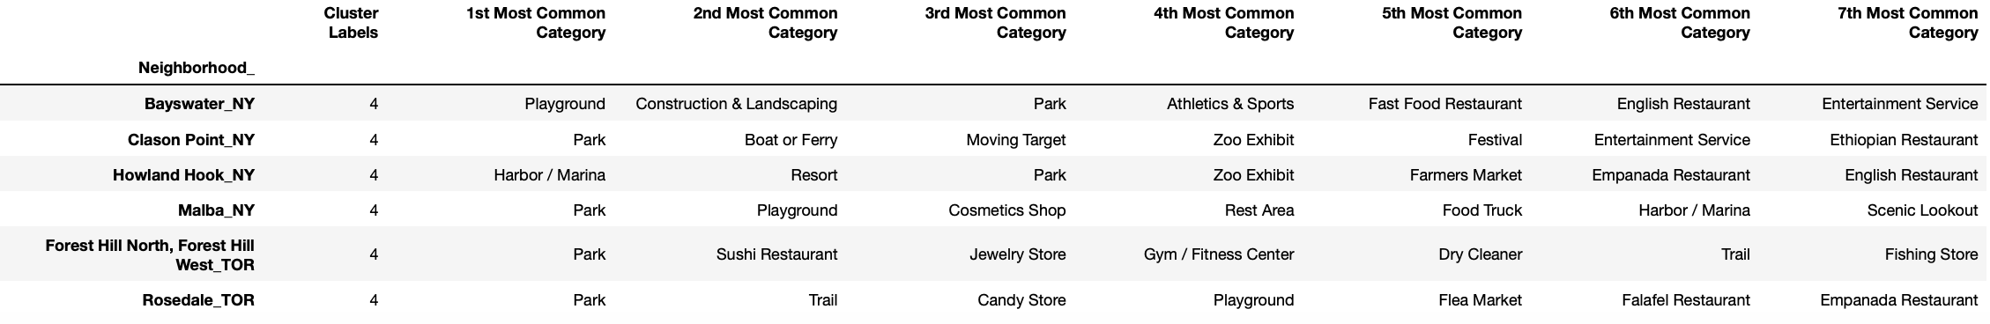
Works cited
Cluster 5
Some records that belong to the fifth cluster

Slide 36
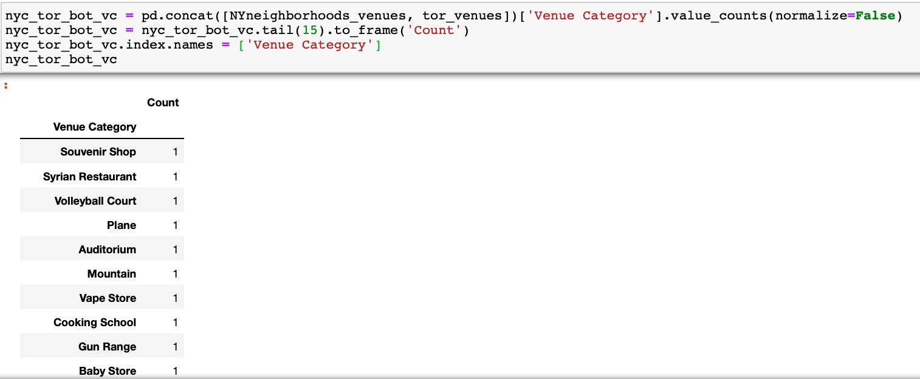
rare venue categories in NY and Toronto

Slide 37
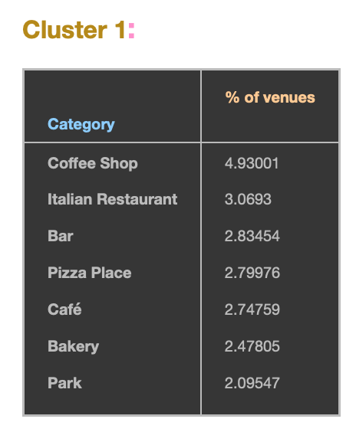
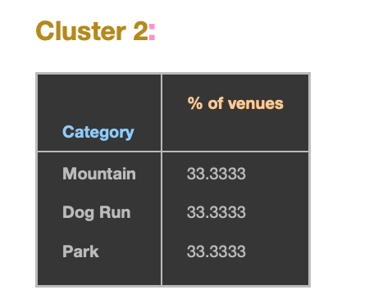
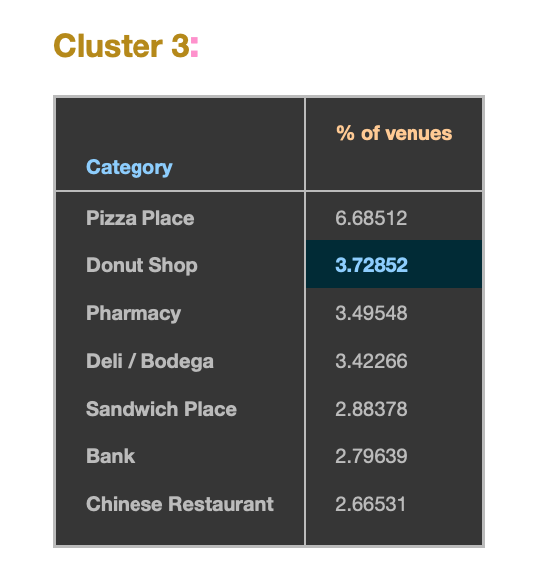
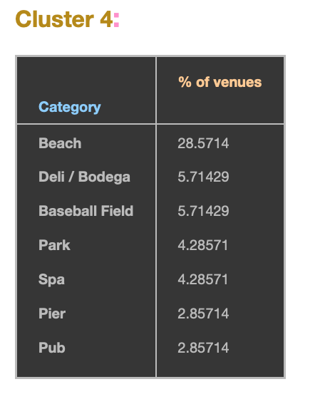
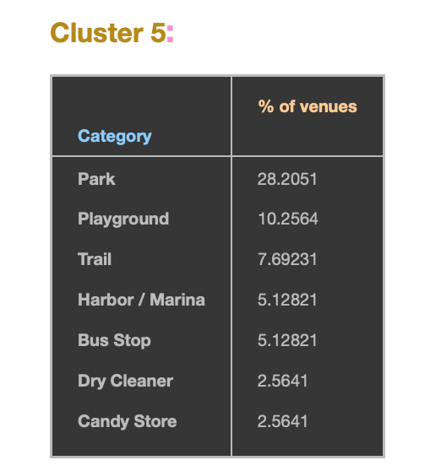
Works cited
Cluster Analysis

Slide 38
Works cited
Cluster Analysis
While Park constitute 2% of venues in the neighborhoods of the first cluster, they constitute 33% of the venues in the second cluster, 4% of the venues in the fourth cluster, and 28% of the venues in the fifth cluster.
Pizza places appear in the most common categories of the first, and third clusters only.
Italian restaurants appear in the most common categories of the First cluster only.
Chinese restaurant appear in the most common categories of the third cluster only
Beach is a very popular category in cluster four.

Slide 39
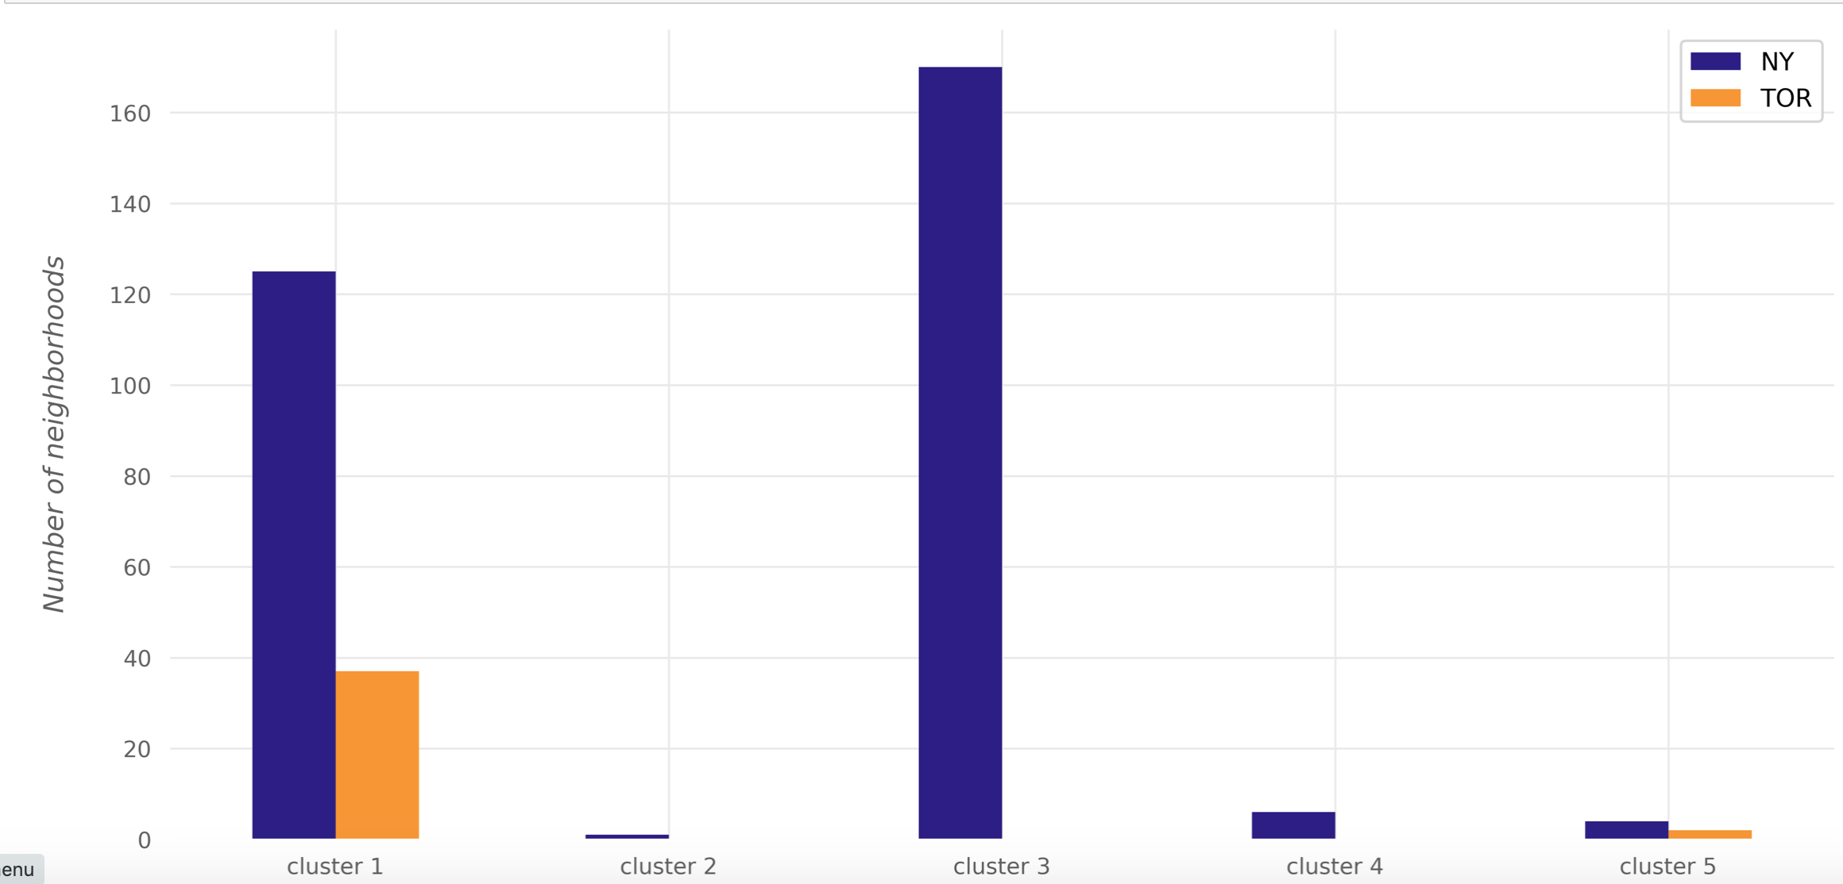
Cluster analysis
The number of NYC and Toronto neighborhoods in each cluster

Slide 40
Conclusion
The results showed that there are venue categories that are common in some of the clusters than the others
The most common venue categories differ from one cluster to the other.
There are rare venue categories in each city
Some venues are more popular than other venues in the same cluster.
K-Means clustering algorithm can be effectively applied to find similarity or dissimilarity of neighborhoods.

